Slide 1
A Seminar on Secure mobile data transfer
Team Details
K. Praneeth Reddy(20EG10521)
K. Varchas Reddy(20EG105320)
P. Sai Nagendra(20EG105337)
Project Supervisor
Mrs. P. Aparna
Assistant professor

Slide 2
Introduction
Welcome to our Credentials Migration Platform, inspired by the innovative LAN-based model addressing the challenges of managing credentials within the Trusted Execution Environment (TEE) of mobile devices. This website revolutionizes the security and usability of mobile TEEs during device lifecycle events. Users can seamlessly migrate sensitive credentials between devices through a secure login process, requesting and receiving keys from a group manager. Leveraging the power of immutable record-keeping on the blockchain, every data change is transparently recorded and verified, ensuring the highest standards of security. Embrace a new era of credential migration with our platform, offering unparalleled protection against information disclosure and elevating the overall security landscape of mobile TEEs.

Slide 3
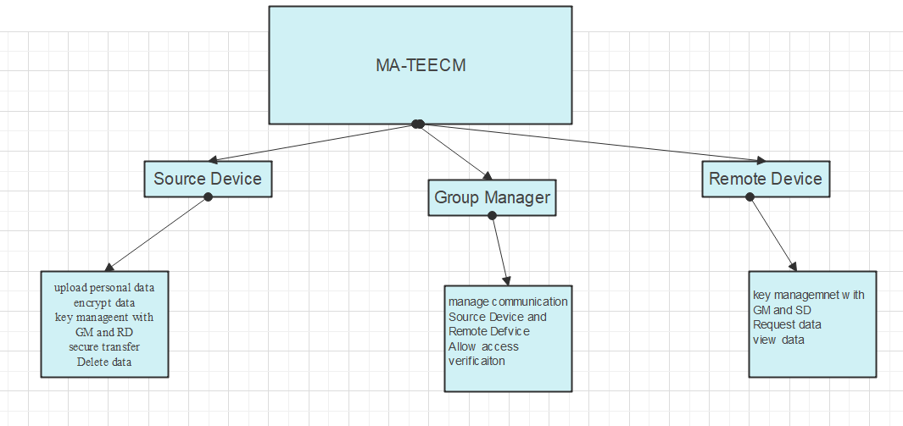
Concept Tree

Slide 4
Literature
Author | Strategies | Advantages | Disadvantages
M. Sabt, M. Achemlal, and A. Bouabdallah | Trusted Execution Environment (TEE) | Integrity: TEE helps maintain the integrity of code and data by preventing tampering or unauthorized modifications. Secure Key Storage: provide a secure location for storing cryptographic keys, enhancing the security of cryptographic operations. | TEEs might not be suitable for all types of applications. Certain use cases may benefit more from other security models or technologies.
Alice et al | Mutual Anonymous Authentication-Based Credential migration framework | - Enhanced privacy during credential migration -reduced risk of information disk closure | - Increased computational overhead -Complexity in information

Slide 5
Literature
Author | Strategies | Advantages | Disadvantages
Dave and Lee | Group Signature-Based Authentication | - Group authentication adds an extra layer of security -Prevents unauthorized access | - Overhead in managing group memberships and signatures -complexity in key management within the group
Carol et al | Blockchain Integration for Immutable Record- Keeping | - Tamper-resistant record-keeping on the blockchain -Enhanced auditability and accountability | - Potential challenges in blockchain integration -blockchain scalability concerns

Slide 6
Problem Statement
As mobile devices are more and more commonly used in business, finance, and information technology, the coexistence of sensitive data and normal data on mobile terminals is becoming very common. For example, Bring Your Own Device (BYOD) is a policy that allows employees to use their personal mobile devices to access office areas to process corporate data and login Intranet applications . Many enterprises accept it by creating secure containers on employees’ personal mobile devices to ensure data security. However, because sensitive data, such as user credentials, are tightly coupled with mobile devices, when an user tries to migrate data to a new device due to a device’s lifecycle events
Existing Method:
Based on a public resource known as the Open Certificate Platforms (OCP) authors proposed a trusted domain certificate migration protocol. They recommended encrypting and backing up the credentials on a trusted server with a password known only to the user and then completing the credential migration by entering the password again. The protocol framework does not require complex user interaction and authentication processes; however, all user credentials must be stored in the server in clear text, and the migration process becomes the process of reconfiguring the backup files in the server
Disadvantages:
Although a key known only by users protects the process, the architecture lacks a discussion on the identity authentication between the OCP and the two devices’ TEE.
There is a privacy breach due to the service provider’s full access to user credentials and personal data.

Slide 7
Problem Illustration
Existing methods stored data in third party server which causes data breaches and data loss of data to solve this problem a method which uses key management system with group manager and communication link between source and destination device and move data from source to destination with out storin in third party servers.
data | attacks | Data Management
User personal data | Data stored in third party server | Third party server
Key management | Security key is provided by third party | Third party server
Data management | Changes of loosing data | Data privacy
 |  | Data attack and privacy loss is issue in third party

Slide 8
Proposed Method
Our advanced method designed to elevate the security and privacy of credential migration. In this approach, a Group Manager (GM) takes center stage, operating as a secure intermediary within a Trusted Execution Environment (TEE). The GM meticulously verifies TEE integrity, ensuring only legitimate devices partake in the migration. Employing cryptographic measures, GM crafts group signatures and issues membership certificates, fortifying the security of data transmission. A shared and encrypted interaction channel, orchestrated by GM, establishes a seamless conduit for authorized TEEs to exchange keys and data securely. Mutual Anonymous Authentication, inspired by the MA-TEECM model, adds an extra layer of privacy as both source and destination devices authenticate each other without revealing sensitive details. Furthermore, WSCM integrates immutable record-keeping on the blockchain, transparently recording every credential migration step for heightened security and auditability. This comprehensive approach sets WSCM apart, offering unparalleled protection and reliability in the intricate landscape of credential management

Slide 9
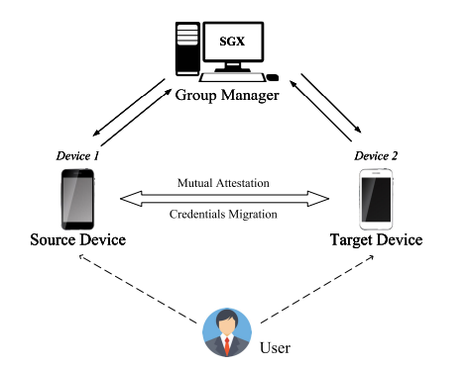
Proposed Method Illustration

Slide 10
Parameter
The parameters and formula for the Integrity Verification using HMAC:
Parameters:
IVK (Integrity Verification Key): A secret key shared between the sender and receiver for HMAC calculation.
TEE_data (Trusted Execution Environment data): The data associated with the Trusted Execution Environment whose integrity is being verified.
Nonce_or_timestamp: A random nonce or timestamp (optional but recommended for enhanced security).
Formula:
Sender Side:
Input Message Construction:
Input_Message = Concatenate(nonce_or_timestamp, TEE_data)
HMAC Calculation:
Calculated_HMAC = HMAC(IVK, Input_Message)
Transmission:
Transmit Calculated_HMAC along with TEE_data.
Transmission:
Transmit Calculated_HMAC along with TEE_data.
Receiver Side:
Recreation of Input Message:
Recreated_Input_Message = Concatenate(received_nonce_or_timestamp, received_TEE_data)

Slide 11
HMAC Recalculation:
Recalculated_HMAC = HMAC(received_IVK, Recreated_Input_Message)
Comparison and Verification:
If Recalculated_HMAC matches the received_HMAC, the TEE_data is considered valid; otherwise, it is considered invalid
Group Signatures and Certificates:
Parameters:
Group_Signature: Cryptographic signature generated for the group, ensuring authenticity and integrity.
GMC_source (Group Membership Certificate for the source TEE): Certificate validating the membership of the source TEE in the group.
GMC_destination (Group Membership Certificate for the destination TEE): Certificate validating the membership of the destination TEE in the group.
Formulas:
Group Signature Generation:
Group_Signature = Generate_Group_Signature(TEE_data, Group_Signing_Key)
Group Membership Certificate Issuing for Source TEE:
GMC_source = Issue_Group_Membership_Certificate(Source_TEE_Public_Key, Group_Signature)

Slide 12
Mutual Anonymous Authentication:
Parameters:
Private_Key_source and Public_Key_source: Key pair for the source TEE.
Private_Key_destination and Public_Key_destination: Key pair for the destination TEE.
b, t1, t2: Random numbers generated by TAs.
c, ω1, ω2, T1, T2: Intermediate variables used in the mutual anonymous authentication protocol.
Formulas:
Random Number Generation by TAs:
b ∈ [Y - 2lb, Y + 2lb]
t1 ∈ [0, 1]^(α(ls+lc))
t2 ∈ [0, 1]^(α(lb+lc))
Calculation of Intermediate Variables:
T1 = E^b mod n = g^(s^(-1)b^2) mod n
T2 = g2^b mod n
d1 = T1^(t1) mod n ,d2 = g2^(t2) mod n
c = Hash(g2||T1||T2||d1||d2||m||TS1)
ω1 = t1 - c(s - X)
ω2 = t2 - c(b - Y)

Slide 13
Immutable Record-Keeping Blockchain Integration:
Parameters:
Transaction_Hash (Hash): The hash of each transaction recorded on the blockchain.
Block_Hash (Block_Hash): The hash of each block in the blockchain.
Timestamp: The timestamp indicating when a transaction is added to the blockchain.
Formulas:
Transaction Hash Calculation:
Transaction_Hash = Hash(Transaction_Data || Previous_Block_Hash || Timestamp)
Block Hash Calculation:
Block_Hash = Hash(Block_Data || Previous_Block_Hash || Timestamp)

Slide 14
Experiment Environment
Java Jdk 1.8
Netbeans IDE 8.0.1
Mysql 8

Slide 15
Project status
S.No | Functionality | Status (Completed /in-progress/Not started)
1. | Literature Survey | Completed
2. | Planning and Design | In Progress
3. | Implementation | Not Started
4. | Closure | Not Started

Slide 16
References
[1] A Ltd. Arm Delivers Record Revenues and Record Profits in FY21. Accessed: May 13, 2022. [Online]. Available :https ://www.arm.com/ja/company/news/2022/05/arm-delivers-recordrevenues-and-record-profits-in-fy21
[2] Arm Achieves Record Revenue and Shipments in Q1 FY 2022. Accessed: Aug. 9, 2022. [Online]. Available: https://www.arm.com/ja/company/ news/2022/08/arm-achieves-record-revenue-and-shipments-in-q1-fy2022
[3] R. Ballagas, M. Rohs, J. G. Sheridan, and J. Borchers, ‘‘BYOD: Bring your own device,’’ in Proc. Workshop Ubiquitous Display Environ. (Ubicomp), vol. 2004, Sep. 2004.
[4] M . Sabt, M . Achemlal, and A. Bouabdallah, ‘‘Trusted execution environment: What it is, and what it is not,’’ in Proc. IEEE Trustcom / BigDataSE /ISPA, vol. 1, Aug. 2015, pp. 57–64.
[5] T. Hardjono and G. Kazmierczak. (2008). Overview of the TPM Key Management Standard. TCG Presentatio

Slide 17
[6] L. Karlsson and M. Hell, ‘‘Enabling key migration between noncompatible TPM versions,’’ in Proc. Int. Conf. Trust Trustworthy Comput . Cham, Switzerland: Springer, 2016, pp. 101–118.
[7] K. Kostiainen , N. Asokan, and A. Afanasyeva, ‘‘Towards user-friendly credential transfer on open credential platforms,’’ in Proc. Int. Conf. Appl. Cryptogr . Netw . Secur. Berlin, Germany: Springer, 2011, pp. 395–412.
[8] G. Arfaoui, S. Gharout, J.-F. Lalande, and J. Traoré, ‘‘Practical and privacypreserving tee migration,’’ in Proc. IFIP Int. Conf. Inf. Secur. Theory Pract. Cham, Switzerland: Springer, 2015, pp. 153–168.
[9] H. Li, Z. Li, Z. Wang, and X. Chang, ‘‘Authorization credential migration method, terminal device, and service server,’’ U.S. Patent 16 476 988, Nov. 21, 2019.
[10] N. Kumar, ‘‘Identity authentication migration between different authentication systems,’’ U.S. Patent 10 412 077, Sep. 10, 2019.
[11] C. Shepherd, R. N. Akram, and K. Markantonakis, ‘‘Remote credential management with mutual attestation for trusted execution environments,’’ in Proc. IFIP Int. Conf. Inf. Secur. Theory Pract. Cham, Switzerland: Springer, 2018, pp. 157–173.
[12] T. Liang and S. Min, ‘‘TPM2.0 key migration-protocol based on duplication authority,’’ J. Softw., vol. 30, no. 8, pp. 2287–2313, 2019

Slide 18
Thank you

Slide 19
Project seminar–I Evaluation
S.No | Rubrics | Marks
1 | Concept Introduction | 4
2 | Literature and Parameter | 5
3 | Problem and Problem Illustration | 8
4 | Proposed Method and Illustration | 8
Total |  | 25

